Slide 1
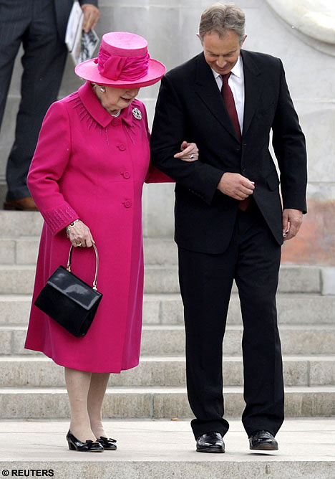
Lecture 10 – Thatcher to Blair
Thatcher’s decline
New Labour - What is it?
New Labour and Gender (women in parliament and women in the workforce)
New Labour and Youth

Slide 2
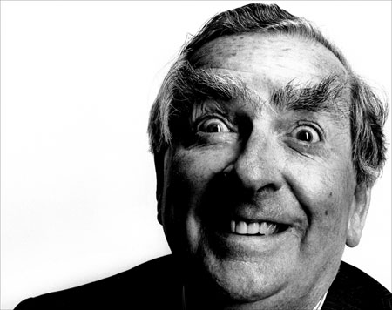
The Great She Elephant
Dennis Healey, the Labour Chancellor in the mid-70s
A row over GCHQ and Union rights
January and February 1984.
Government Communications Headquarter - GCHQ.

Slide 3
What did the Thatcher revolution achieve?
Economy, inflation and unemployment
Stagflation - Monetarism (Reducing the rate of growth of the money supply will reduce inflation without leading to long-term unemployment. )
•Cut public expenditure and roll back the state
•Privatisation
I don’t believe in selling the family silver’ – Harold Macmillan.
•Law and order: the enemy within: strong state
•Unions: miners strike of 1984-1985, GCHQ, Wapping.
Pierre Bourdieu on neoliberalism ‘A programme for destroying collective structures which may impede the pure market logic’.
• Education: national curriculum
• Unemployment
•Taxation
• North/South divide
• Poverty
•Notions of society
•Nationalism

Slide 4

What is New Labour?
Blairism, Blatcherism?
The ‘third way’ between conservatism and socialism?
‘We’re all thatcherites now’. - Peter Mandelson (2002)
Stuart Hall calls New Labour a ‘hybrid regime’ rather than pure ‘AP’
Thatcherite neoliberalism + Social democracy = New Labour

Slide 5
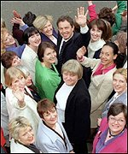
New Labour and Gender 1) Women in parliament
In 1997, 120 women members entered parliament, double the number from 1992.
2 assumptions
i) women’s issues and perspectives are different from men’s
ii) Women in parliament’s issues and perspectives correlate with those of women in society as a whole

Slide 6
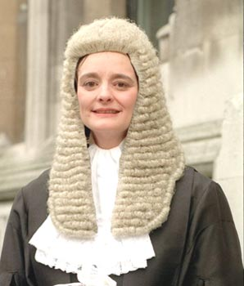
New Labour and Gender 2) Women in the workforce
Minimum wage legislation brought in April 1999, at the rate of £3.60 per hour for those workers aged 22 and over.
Mean gender pay gap narrowed from 26% to 23% from 1994-2002, but the gender pay gap for part-time work has not narrowed.

Slide 7
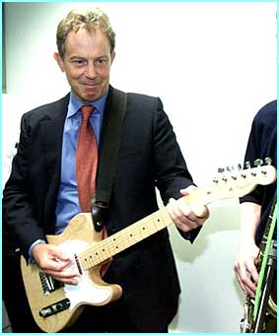
Things can only get better – New Labour and Youth
“I want us to be a young country again. With a common purpose. With ideals we cherish and live up to. Not resting on past glories... but ready for the day’s challenge. Ambitious. Idealistic. United.
.. Eighteen years of hurt never stopped us dreaming. Labour’s coming home’

Slide 8
New Labour’s impact on 1984’s themes
Young people and Unemployment
The Unions
"To secure for all the workers by hand or by brain the full fruits of their industry and the most equitable distribution thereof that may be possible upon the basis of the common ownership of the means of production, distribution and exchange, and the best obtainable system of popular administration and control of each industry of service.“
Clause 4
"a community in which power, wealth and opportunity are in the hands of the many not the few".
1995

Slide 9
Voting turn out by Age1970

Slide 10
Voting turn out by Age 1997

Slide 12
Did things only get better?
Next week - What we have done and evidence?
Contemporary History and the 80s

